Slide 1

islelisten.im

Slide 2

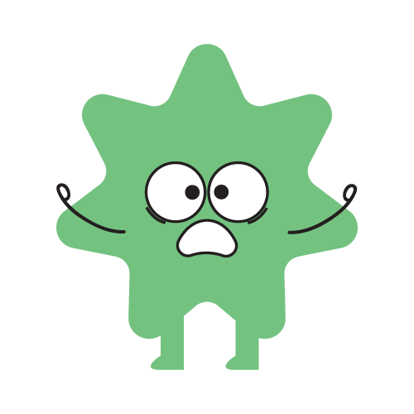
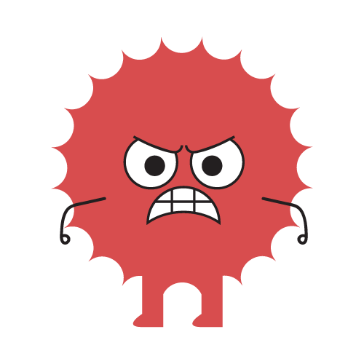
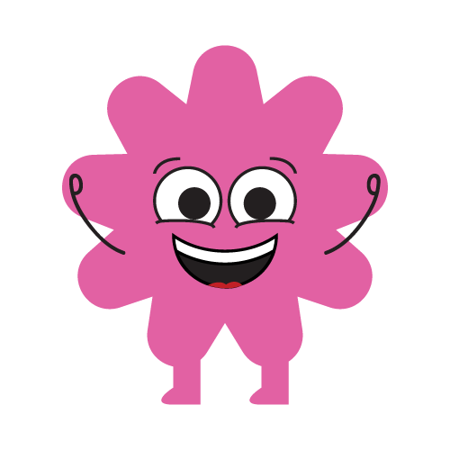
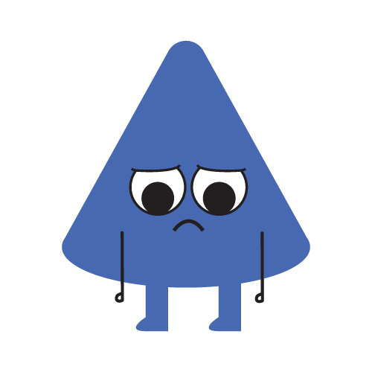
Our mental health is how we…
THINK
FEEL
ACT

Slide 3

Who has mental health?

Slide 4
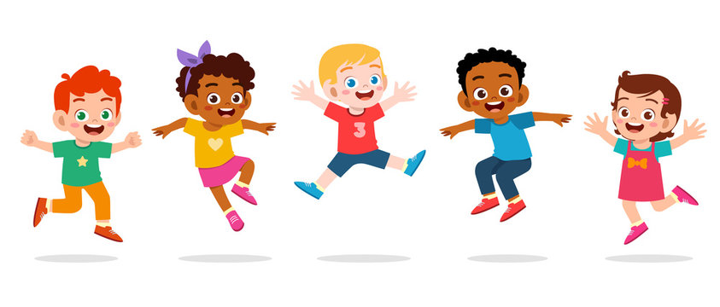
Is everyone's mental health the same?
No, we are all unique!
Notes:
* Talk about the rollercoaster here too.

Slide 5

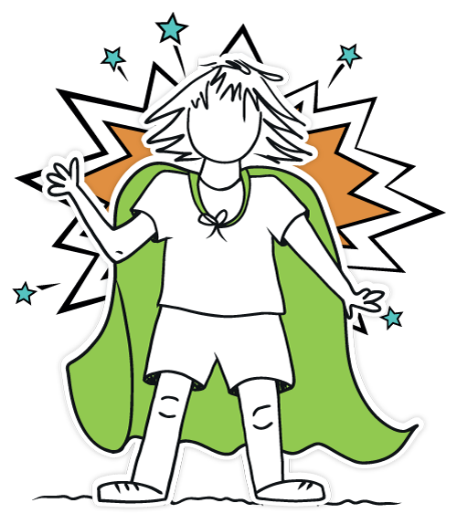
Mental Health Awareness Week
Small actions make a BIG difference
You are never alone. Someone can always help
Notes:
Introduce MHAW

Slide 6
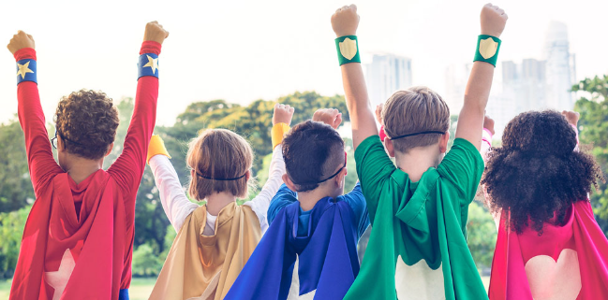
Who is your favourite superhero?
Notes:
I want you to think of your favourite superhero -
Why do we like superheroes so much? (because they help people, they’re kind, they have strong values… and they TAKE ACTION when something is wrong)
Choose a volunteer…they come up to the front.
(give them the cape)
It’s cool to have a cape – but you don’t need a cape to be a superhero. we’re ALL going to imagine we are superheroes right now.
Everyone do a superhero pose…
Because real superheroes don’t just fly or have powers…they take action to help themselves and others. that’s exactly what we’re learning to do today-for our mental health.

Slide 7

- for yourself
Take a deep breath.
Move your body! play, skip, dance!
Do a hobby you love!
Say ‘I can do this’
Notes:
This Mental Health Awareness Week, find your one thing to boost your mental health. Choose one positive action that works for you.
Get the pupils to put their hand up and ask them some things they could do for themselves. Encourage participation & then go over the examples on the power point.

Slide 8
- for others
Smile!
Turn to the person next to you and say something kind.
Take 3 deep breaths
Whisper to the person next to you ‘you can do this’
Let’s do these all together!
Notes:
“The environment we live in impacts our mental health. What can you do to help build mentally healthy communities, workplaces and schools”
Interactive part!
Get the pupils involved.
Show me your best smiles (did you know that smiles are contagious)
Say a kind compliment to the person next to you (don’t be silly, and when you see my hand in the air that’s when I want you to stop talking and look at the front)
Three breaths all together (inhale & exhale) this is calming us down and helping our brain.
Whisper ‘you can do this’ showing encouragement

Slide 9
- for all of us
Include everyone in play.
BE KIND in school, at home & in clubs.
Speak Up.
Encourage people all around you.
Ask for help.
Notes:
Individual actions matter, but they're only part of the story. We all have a part to play in our communities.
“We need those in power to take action to ensure good mental health for everyone in the UK”
Get the pupils to put their hand up and ask them some things they could do for ‘all of us’. Encourage participation & then go over the examples on the power point.

Slide 10
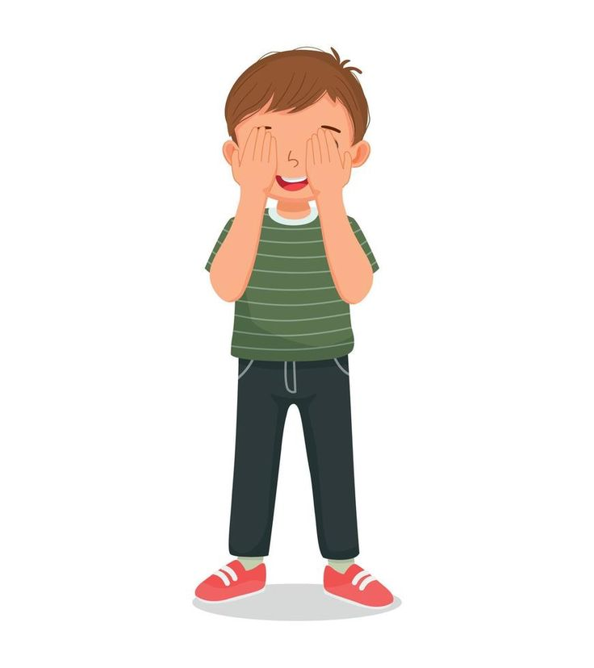
we’re going to close our eyes!
Notes:
Close eyes and create a calm environment to close the session off- think of one small action you can take today to help yourself or someone else feel better. Mention teachers, parents, carers, friends. Can give them a compliment, play with someone, etc. When I come back to do some more sessions, I will be asking you how you have taken action so I can’t wait to hear what you will all say! (depending on time – get some of the kids to put their hands up and share)

Slide 11
Repeat after me – all together!
I CAN TAKE…
Notes:
Repeat all together – and round off the presentation.
(if time – ask if someone would like to share what they have learned today)
Hand back over to teachers.

